Slide 1
Module 2: Mandated Tasks of United Nations Peacekeeping Operations
Lesson
2.6
Conflict Related Sexual Violence

Slide 2
Relevance
Peacekeeping personnel are expected to:
Protect civilians – including from sexual violence in conflict
Protect women and children – especially vulnerable
UN Core Pre-Deployment Training Materials 2017

Slide 3
Learning Outcomes
Learners will:
Explain Conflict Related Sexual Violence (CRSV)
Identify CRSV as a punishable crime
List actions to take to address CRSV
UN Core Pre-Deployment Training Materials 2017

Slide 4
Lesson Overview
Definitions
Importance of Attention to CRSV
Legal Framework
UN Partners Leading in Addressing CRSV
UN Guidance on CRSV
Addressing CRSV in UN Peacekeeping
Roles & Responsibilities
What Individual Peacekeeping Personnel Can Do
UN Core Pre-Deployment Training Materials 2017

Slide 5
Learning Activity
2.6.1
Film: Democratic Republic of the Congo – The Survivors
Instructions:
What is CRSV?
What is the impact on the victims?
Time: 10 minutes
Film: 3:03 minutes
Discussion: 5-7 minutes
https://www.youtube.com/watch?v=8GNgB50MGdw
UN Core Pre-Deployment Training Materials 2017

Slide 6
1. Definitions
“Conflict Related Sexual Violence (CRSV) refers to incidents or patterns of sexual violence in conflict or post-conflict situations which include: rape, sexual slavery, forced prostitution, forced pregnancy, enforced sterilization or any other form of sexual violence of comparable gravity against women, men, girls or boys”.
UN Core Pre-Deployment Training Materials 2017

Slide 7
Realities on the Ground
Vulnerable civilians, situations
Threats
Perpetrators, capacity to act
UN Core Pre-Deployment Training Materials 2017

Slide 8
Differences with Related Issues
Gender based violence (GBV)
Sexual and gender based violence (SGBV)
Sexual exploitation and abuse (SEA)
Harmful traditional practices
“Survival sex”
UN Core Pre-Deployment Training Materials 2017

Slide 9
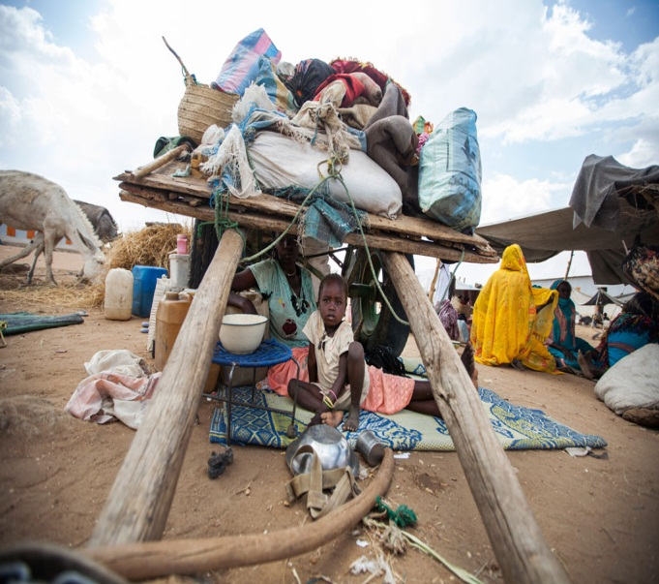
Links with Cross-Cutting Thematic Tasks
Human rights
Protection of civilians (POC)
Women, Peace and Security (WPS)
Child protection
UN Core Pre-Deployment Training Materials 2017

Slide 10
Learning Activity
2.6.2
CRSV or Not?
Instructions:
Consider the scenarios
Is this a case of CRSV or not?
Give reasons
Time: 5 minutes
Group work: 3 minutes
Discussion: 2 minutes
UN Core Pre-Deployment Training Materials 2017

Slide 11
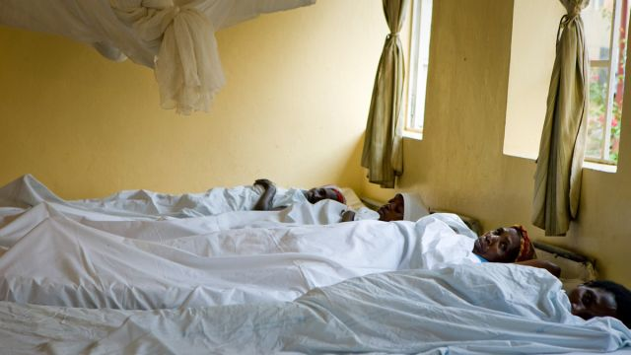
2. Importance of Attention to CRSV
Prevalent in conflicts – tactic of war
Increased risk for women and girls
Traumatic effects
Culture of impunity
UN Core Pre-Deployment Training Materials 2017

Slide 12
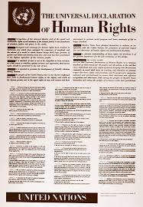
3. Legal Framework
International Law
National law
Security Council resolutions
UN Core Pre-Deployment Training Materials 2017

Slide 13
4. UN Partners Leading in Addressing CRSV
Special Representative of the Secretary-General on Sexual Violence in Conflict (SRSG-SVC)
Team of Experts
UN Action Against Sexual Violence in Conflict
UN Entity for Gender Equality and the Empowerment of Women (UN Women)
DPKO
UN Core Pre-Deployment Training Materials 2017

Slide 14
5. UN Guidance on CRSV
Secretary-General’s Policy Committee Decision No. 2010/30
An Analytical Inventory of Peacekeeping Practice (2010)
Matrix: Early-warning Indicators of CRSV
DPKO-DFS Policy on Prevention and Response to CRSV for UN Peacekeeping Operations
UN Core Pre-Deployment Training Materials 2017

Slide 15
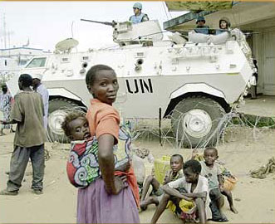
6. Addressing CRSV in UN Peacekeeping
Prevention and response measures
Political dialogue and advocacy
Community engagement
UN presence for vulnerable areas/populations
Situational awareness, early-warning, operational readiness,
commitment
UN Core Pre-Deployment Training Materials 2017

Slide 16
Coordination with UNCT
UNCT coordinates services for survivors:
Health care
Psychosocial support
Legal aid
Socio-economic reintegration services or livelihood support
UN Core Pre-Deployment Training Materials 2017

Slide 17
Learning Activity
2.6.3
Responding to CRSV
Instructions:
Consider the case study
Identify the perpetrators and their motives
What would you have done to protect the victims?
What support do the survivors need?
Time: 10 minutes
Group work: 5-7 minutes
Discussion: 3 minutes
UN Core Pre-Deployment Training Materials 2017

Slide 18
7. Roles & Responsibilities
Women Protection Adviser (WPA)
Advise mission leadership
Mainstream CRSV issues
Establish monitoring, analysis and reporting arrangements (MARA)
Carry out prevention activities
Dialogue with parties to the conflict
Strengthen coordination
Training and capacity-building
Goal
Prevent & Respond to CRSV
UN Core Pre-Deployment Training Materials 2017

Slide 19
Other Units
Gender Adviser
Protection of Civilians
Child Protection
Human Rights
JOC/JMAC
SRSG’s Office
Rule of Law/Judicial Affairs
SSR
DDR
Political Affairs
Corrections
Civil Affairs
Public Information
UN Core Pre-Deployment Training Materials 2017

Slide 20
Special Roles of Military & Police
Physical protection
Proactive approach
Monitoring and reporting
Investigations
Prevent & Respond to CRSV
UN Core Pre-Deployment Training Materials 2017

Slide 21
8. What Individual Peacekeeping Personnel Can Do
Support and encourage local authorities in addressing and combatting CRSV
Consult women and men
Talk to women and men separately
Be proactive to prevent CRSV
Respond to potential/actual threats
Share information
Locate local organizations for victim assistance
UN Core Pre-Deployment Training Materials 2017

Slide 22
Summary of Key Messages
CRSV – sexual violence in conflict/post-conflict situations, “tactic of war”
CRSV is a punishable crime
Take action – consult women, be proactive, coordinate, intervene
UN Core Pre-Deployment Training Materials 2017

Slide 23
Questions
UN Core Pre-Deployment Training Materials 2017

Slide 24
Learning Activity
Learning Evaluation
UN Core Pre-Deployment Training Materials 2017

